Slide 1
Modern AI
Navigating the Generative Revolution
Andriy Burkov
Québec, Canada

Slide 2
About me in AI
PhD in multiagent systems (2011)
Fujitsu and Gartner
Three bestselling books
Newsletter with nearly 1M subscribers
Advisor to tech startups

Slide 3
WHAT HAPPENED IN 2023?
OpenAI put AI in the hands of laymen
An avalanche of strong and stronger models from big tech
From writing complex code (and years of experience) to simple “I need”
A fusion of modalities (not only text)
Text: From highlighting to rewriting
Style adaptation
Summarization
Paraphrasing
Writing from scratch

Slide 4
Big Use cases
The initial 70%
Brainstorming
Coding
Adaptation
Transform A to look like B
Write a new piece in B’s style
Self-education
An instant access to a (hallucinating) Harvard professor’s advice
Scientific research

Slide 5
BIG Problems (Likely unsolvable)
Hallucinations
Close tie to the training data
Context size

Slide 6
Tool with a Catch
A drill drills holes
A hammer hammers nails
What does a language model do?
Training data is hidden
Even if it wasn’t, we couldn’t “study” it
Unknown whether the user will save time or waste it
Fails where real thinking is needed
You only think it thinks because your brain fools you into thinking it does
True unknowns, planning, weighting risks, humor, sarcasm -> No agency

Slide 7
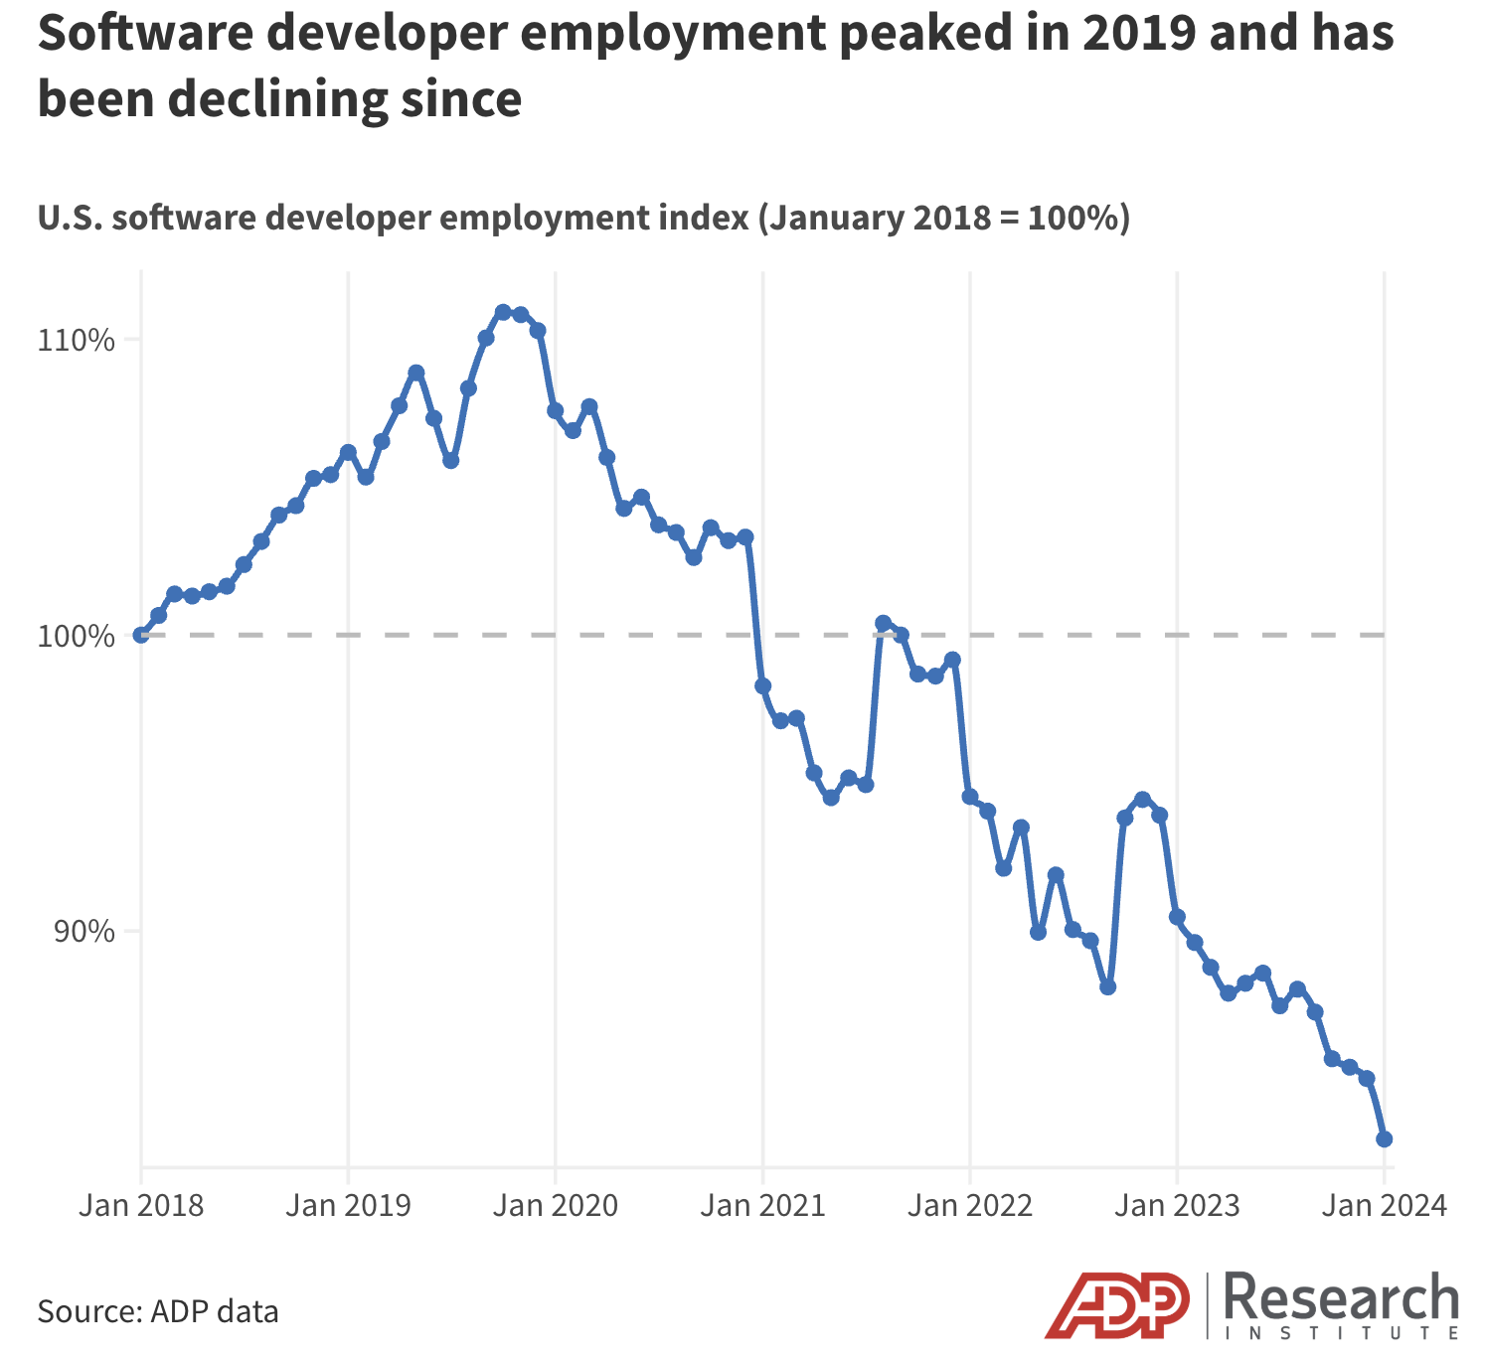
AI in Business and WORK
Absence of agency makes it impossible to replace an entire profession with an AI
In some professions, productivity boost makes large teams unnecessary
Translators
Copyeditors
Proofreaders
Online content moderators
Copywriters
Junior software engineers
Data analysts
Paralegals

Slide 8
New Professions ARISE
For people who “understand” AI and can “feel” what AI can and cannot do
Expertise in how it works
Years of practical hands-on experience
Innate talent
For people who pay attention to detail
Validation and correction of AI output
Interactive problem solving

Slide 9
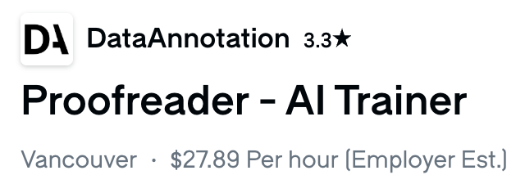
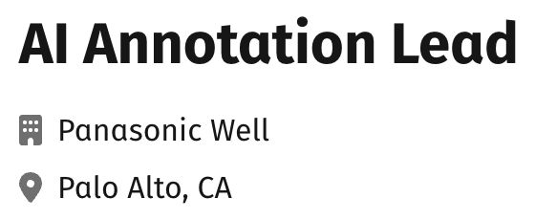
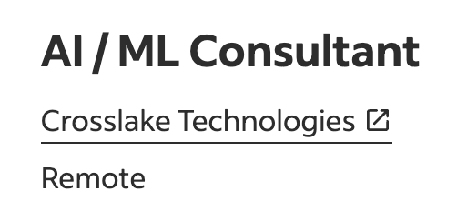
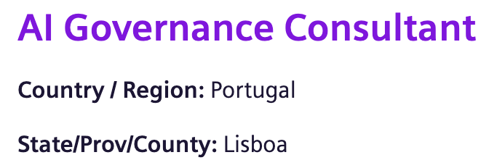
New Job Titles

Slide 10
Old Skills
AI Trainer
Work: Finetuning models on specific language pairs and task domains
Skills: Natural languages, code scripting, principles of model training
AI Data Annotator
Work: Craft training examples for AI models
Skills: Problem analysis, attention to detail, writing
Prompt Engineer
Work: Write task specifications for language models
Skills: Problem analysis, systems thinking, attention to detail, technical writing
AI Auditor / Quality / Governance Analyst
Work: Interact with an AI-based system and find flaws
Skills: Creativity, problem analysis, attention to detail

Slide 11
Future-Proof Your Career
Learn to think like an engineer
Focus on problem-solving, iterative improvement, breaking down complex tasks
Sharpen critical thinking
Learn to question AI outputs and spot errors, deviations from instructions, made up facts
Build AI intuition
Develop a "feel" for what AI excels at and where it struggles
Embrace continuous learning
Try new models, try old models on new problems, learn how X works
Develop human-centric skills
Leadership, communication, collaboration, empathy, creativity

Slide 12
How to Continuously Learn
Online learning platforms (e.g., Coursera)
Courses on how to use AI for solving problems, how machine learning works
Newsletters (e.g., True Positive Weekly)
Ask the AI
Ask about everything
Be cautious of hallucinations—verify!

Slide 13
Conclusion
Modern AI is a powerful tool with unpredictable skillset
It's a tool, not a wholesale replacement for skilled professionals
Understanding its capabilities and limitations is paramount for effective use
Engineering mindset, critical thinking, creativity, leadership, collaboration, attention to detail, technical writing are skills to develop and continuously improve
Be Curious. Be Critical. Keep Learning. Adapt.

Slide 14
Questions?
Andriy Burkov
LinkedIn: https://www.linkedin.com/in/andriyburkov
X: https://x.com/burkov
Books:
The Hundred-Page Machine Learning Book (2019)
The Hundred-Page Language Models Book (2025)

